Slide 1
New Jersey Return Additional Entries
NJ 1040 Instructions
NJ Special Handling Document on TaxPrep4Free.org
www.state.nj.us/treasury/taxation
NJ 1040-Lines 30, 45 & Dependents Worksheet

Slide 2
NJ Return – Mostly Filled in Already
Most of the information on the NJ return is already filled in by the time you have finished the Federal return
Most fields are automatically calculated from Federal entries (e.g. - Self employment)
Sometimes you must signify special NJ treatment by using fields on the federal screens (e.g. - State adjust on Interest Stmt or special boxes on some screens)
Other times you will have made additional manual entries or adjustments on the NJ forms as part of the data entry for the federal form (e.g. Gubernatorial Elections Fund or Property Tax on NJ Worksheet F)
Notes:
The assumption here is that special NJ treatment fields AND the additional manual entries or adjustments have been made as part of handling federal data entry.
This is not required by TW – entries can almost always be made in any order
Instructions for special fields and adjustments are given in the slides covering both federal and NJ entry for each topic
Many experienced preparers are used to not doing anything on the NJ return screens until the federal screens are done
There is nothing “wrong” with this, but we encourage (wherever possible) that all entry for a tax form / tax issue be done at the same time to facilitate effective interviewing and to minimize needing to remember (and often forgetting) to do something later

Slide 3
Additional NJ Return Entries
There are a few situations which require additional manual entry on NJ TW screens
Some things are unique to NJ (e.g. - Use Tax)
Some things must wait until the federal return is complete or depend on values only available on the NJ return (e.g. – federal pre-tax / NJ after-tax medical expenses)
The next few slides will cover these additional entries on the NJ return

Slide 4
Types of Additional Entries on NJ Return
Adding Non-Dependents Who Qualify for NJ Earned Income Tax Credit
Checking boxes for NJ dependents with no health insurance
Entering Federal Pre-Tax Medical Expenses(NJ After Tax)
Entering Use tax due on out of state purchases
Entering rent

Slide 5
Non-Dependents Who Qualify for NJ Earned Income Tax Credit
If TP qualifies for EIC, then all EIC qualifying individuals must be listed on NJ 1040, Line 13 (even if they are not a dependent and do not qualify for an exemption)
Dependents with Code 1, 2, 3 on Main Info screen are automatically listed on both the Federal and NJ returns
If a person does NOT qualify for an exemption, but IS still involved in qualifying for EIC (i.e. - Code 0 on Main Info screen), then that person is not listed on the Federal 1040, but MUST be listed on the NJ 1040 – TW does NOT do this automatically
TW Tip: Manually add to the NJ Dependents Worksheet (via override F8)
Notes:
Dependent does not have health insurance
Does not affect NJ tax calculations
May be used by state to encourage participation in NJ child health care programs
No need to list Code 0 persons on NJ return if TP does not qualify for EIC
Amount of Federal EIC is based on number of qualifying children; NJ EITC amount is based on a percentage of Federal EIC. If a non-dependent Code 0 child is a qualifying child for Federal EIC but is not listed on NJ return, the NJ EITC amount will appear to be incorrect. This situation will almost certainly guarantee an investigation by the NJ Division of Taxation. Taxpayer will receive a letter asking for clarification. There will be a delay in receiving refund

Slide 6
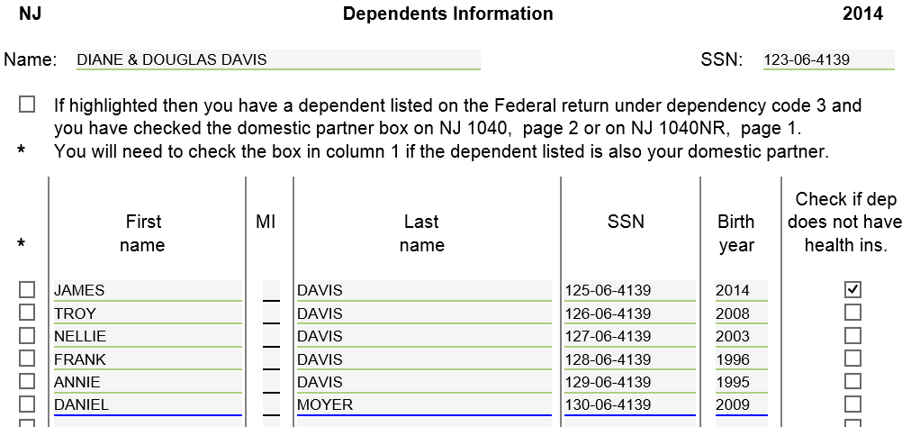
TW Dependents Worksheet
If TP is receiving NJ EITC, manually add any missing Code 0 EIC qualifying individuals, using override F8 (underlined in blue)
Notes:
Must use override on each field separately
If counselor is not allowed to do overrides, must ask ERO for help

Slide 7
NJ Dependents with No Health Insurance
Must manually indicate any dependent who is not covered by health insurance
Check box on NJ Dependents Worksheet. TW will then check health insurance box on NJ 1040 Line 13
Has no impact on tax return
Used to get more people covered through NJ health insurance programs

Slide 8
TW Dependents Worksheet

Slide 9
Federal Pre-Tax Medical Insurance Expenses
Pre-tax medical insurance through employer
TP pays premiums with before-tax money, reducing taxable wages
W-2 Box 1 shows Federal Wages after pre-tax health insurance premiums are subtracted
TP receives tax benefit of reduced wages, so can’t itemize as medical expense on Sch A
NJ does not consider these premiums pre-tax, so W-2 Box 16 shows gross State Wages
Difference between Federal and State Wages on W-2 a clue that TP paid pre-tax premiums. Probe with client
May be able to claim premiums as medical expense on NJ 1040 Line 30
Obtain pre-tax medical expenses from TP’s last pay stub for year
Identify which pre-tax deductions are medical. Can be other things too
These pre-tax benefits often called Cafeteria or Section 125 plans
Allow TP to choose personalized mix of benefits (medical, dental, vision, legal services, day care, etc.) under Section 125 of the tax laws

Slide 10
NJ 1040, Line 30 – Medical Expenses Pre-Tax Federal (After-Tax NJ)
Up to this point, tax return should already include:
Federally allowed medical expenses entered on A Detail screen
Even if below Federal 10%/7.5% threshold
You may be able to claim allowable pre-tax Federal medical expenses on NJ 1040-line30 Medical Expenses
Only when total medical expenses exceed 2% of NJ Gross Income. Counselor must calculate

Slide 11
NJ 1040, Line 30 – Medical Expenses Pre-Tax Federal (After-Tax NJ)
(cont’d)
TW Tips:
Do not enter this information until after Federal Sch A Medical and NJ Line 28 Gross Income amounts are finalized
Also run Diagnostics to make sure there are no issues that might affect these amounts
Entry is via scratch pad attached to NJ 1040, Line 30
If Sch A Medical or NJ line 28 amounts change later (e.g. during QR), then don’t forget to make any needed manual adjustments to scratch pad
What you put on scratch pad depends on whether line 30 already shows a non-zero amount
NJ Special Handling has summary of procedure

Slide 12
Federal Pre-Tax/NJ After-Tax Medical Counselor Action – Case 1
If NJ 1040 Line 30 already > 0 Means other Sch A medical expenses already ≥ 2% of NJ gross income | Enter full amount of NJ after-tax premiums on scratch pad. TW will just add to amount already on NJ 1040 Line 30

Slide 13
Federal Pre-Tax/NJ After-Tax Medical Example Scratch Pad – Case 1

Slide 14
Federal Pre-Tax/NJ After-Tax Medical Counselor Action – Case 2
If NJ 1040 Line 30 = 0 Means other Sch A medical expenses < 2% of gross income | Enter on scratch pad: NJ after-tax premium amount Sch A medical expenses (if any) 2% of NJ gross income (NJ 1040 Line 28) as a negative amount TW will add after-tax premium amounts to Sch A medical expenses & subtract 2% of income. Total will be carried to Line 30 If result < 0, delete scratch pad

Slide 15
Federal Pre-Tax/NJ After-Tax Medical Example Scratch Pad – Case 2

Slide 16
Use Tax Due on Out-of-State Purchases: NJ 1040 Page 3 Line 45
NJ-1040 Instructions
From NJ-1040 Instructions:
“When you purchase taxable items or services to be used in New Jersey but do not pay sales tax, you owe use tax. This commonly occurs when purchases are made on the Internet, by phone or mail order, or outside the State from sellers who do not collect New Jersey sales tax. The New Jersey use tax rate is the same as the sales tax rate: 7%. If you paid sales tax to another state at a rate less than 7% on a purchase that would have been taxed in New Jersey, you owe use tax based on the difference between the two rates. …”
Notes:
Must ask the client if they had made purchases out of state, on Internet, by phone or by mail order
Only for items that would have been taxable in NJ (e.g. - not food)
If not “used” in NJ, then no NJ Use Tax due (e.g. - TV used in cabin in Maine)
Penalties for not paying Use Tax can be surprisingly severe

Slide 17
Use Tax Due on Out-of-State Purchases: NJ 1040 Page 3 Line 45
NJ-1040 Instructions
(cont’d)
For total of items/services costing < $1,000 each
With receipts, can use 7% of purchase amount(s) (minus any sales tax paid) OR
Can use Estimated Use Tax Chart to estimate Use Tax due based on income
For each item/service costing $1,000 or more
Must calculate exact Use Tax due
Use Tax due for these items is in addition to total for items/services costing < $1,000 each
If no Use Tax due, must enter 0 on line 45
See Worksheet G in NJ 1040 Instructions for more detail

Slide 18
Use Tax Due on Out-of-State Purchases: NJ 1040 Page 3 Line 45
(cont’d)
TW Tips:
If no Use Tax due, then just “get the red out” for NJ-1040 Line 45
If any Use Tax due, use scratch pad off Line 45 to document calculation(s)
Will still need to “get the red out” for Line 45

Slide 19
TW NJ Use Tax Due - NJ 1040 Page 3 Line 45
Items < $1K
Item $1k or more
Item > $1K-Tax partially
paid
Notes:
Shows the three different cases where Use Tax needs to be accounted for:
When Use Tax for any items less than $1000 is estimated based on Estimated Use Tax chart
When no tax paid on an item more than $1,000
When Sales Tax is partially paid

Slide 20
NJ Use Tax Due: NJ 1040 Page 3 Line 45
From scratch pad;
still must “get red out”
Note: Must enter 0 (and “get red out”)
if no Use Tax due

Slide 21
Rent on Worksheet F
If rent has not been included on Worksheet F already, be sure to enter it now (covered in detail in previous module)

